Slide 1
ECE 322L Electronics 2
03/24/20- Lecture 16
AC load line
Maximum symmetrical swing

Slide 2
Updates and overview
Midterm will be available on UNM Learn starting on Tue 03/31/2019, 10:30 am and it will be due on on Tue 03/31/2019 via upload to UNM Learn at 12:30 pm.
Focus: DC and AC analysis of the BJT.
See the practice problems on UNM Learn to get
a better idea of the format.
We will be going to the frequency response of amplifiers next (Neamen Ch. 7).
A handout on Bode plots and simple transfer functions is on UNM Learn (please, study/review before Lecture 17).
Today: AC load line, compliance, and maximum symmetrical swing (Neamen 6.5.2, notes and handouts on UNM Learn).
3/24/20

Slide 3
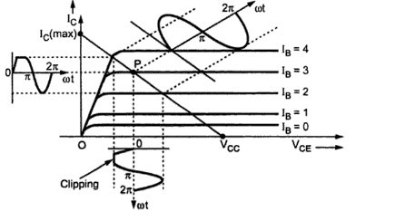
Compliance
Compliance of a voltage amplifier:
Maximum possible output voltage swing for a given amplifier
When the output voltage exceeds the compliance of the amplifier a part of the signal will be clipped and distortion will occur.
Note: The definition can be applied to any current or voltage in the circuit.
3/24/20
Notes:
This slides provides the definition of compliance for a voltage amplifier

Slide 4
Compliance vs Max. Symm. Swing
Compliance of a voltage amplifier:
Maximum possible output voltage swing for a given amplifier
Maximum symmetrical swing of a voltage amplifier
Maximum peak-to-peak value of the output voltage that is symmetrical around the its DC value.
3/24/20
Notes:
This slides specifies the difference between compliance and maximum symmetrical swing. The compliance of a signal is not necessarily symmetrical around its DC value. The compliance of a voltage signal is just the maximum possible voltage swing for that signal. The next two slides will specify the phenomena that limit compliance in a BJT based voltage amplifier.

Slide 5
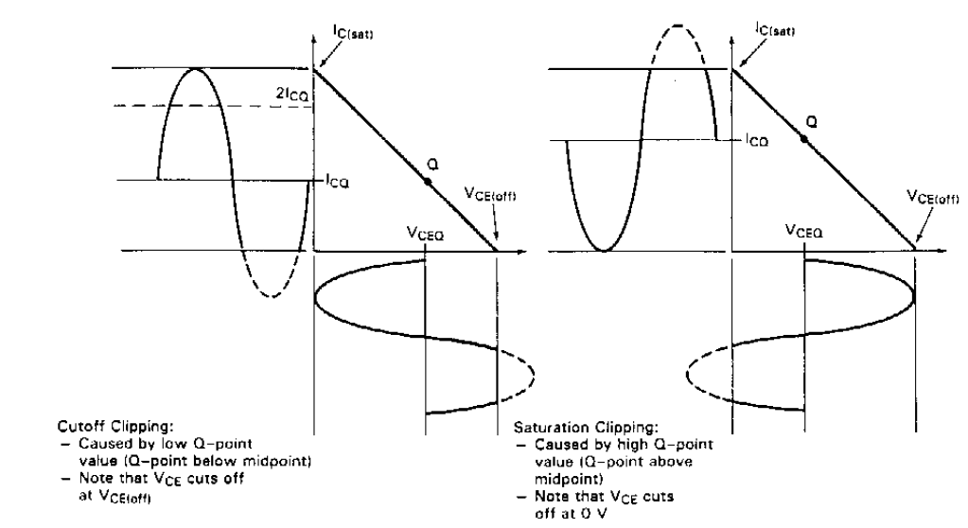
Origin of clipping-Saturation clipping
Clipping occurs because the transistor is no longer in active region, and it goes in cut-off or saturation.
More prone to occurring
when the Q point is
close to saturation
At low v_{CE} The compliance is limited by the BJT entering saturation
3/24/20
Notes:
The compliance of a BJT based voltage amplifier is limited by the BJT going out of the forward active region and into out saturation or cut-off. This slides shows a case where the maximum swing or compliance is limited by the BJT going in saturation. The plot shows the ac load line or the load line of the ac circuit of the amplifier. (In a few slides I will show you how to sketch the load line and how to use it to determine the compliance of a voltage amplifier) The Q point is also marked on the ac load line. Note that the Q is closer to the saturation region than to the cut-off region in this case. The plot also show how the i_{C} and v_{CE} vary as the input signal varies. In other words the Q points moves up and down the ac load line as the input signal oscillates. At v_{CE} lower than v_{CE, sat}~0.1-0.3 V the transistor goes into saturation and both the i_{C} and the v_{CE} are clipped.

Slide 6
Origin of clipping-Cut-off clipping
Clipping occurs because the transistor is no longer in active region, and it goes in cut-off or saturation.
More prone to occurring
when the Q point is
close to cut-off
At high v_{CE} compliance is limited by the BJT entering cut-off
3/24/20
Notes:
This slides is limited by shows a situation where the compliance is limited by the transistor entering in cut-off as the input signal oscillates. This is the case of a Q point closer to the cut-off region than to the saturation region.

Slide 7
Determine the maximum symmetrical swing
The ac load line is used to determine the maximum symmetrical swing (V_{pp}) for a given amplifier.
Note that the ac load-line can also be used to determine the compliance of the amplifier.
3/24/20

Slide 8
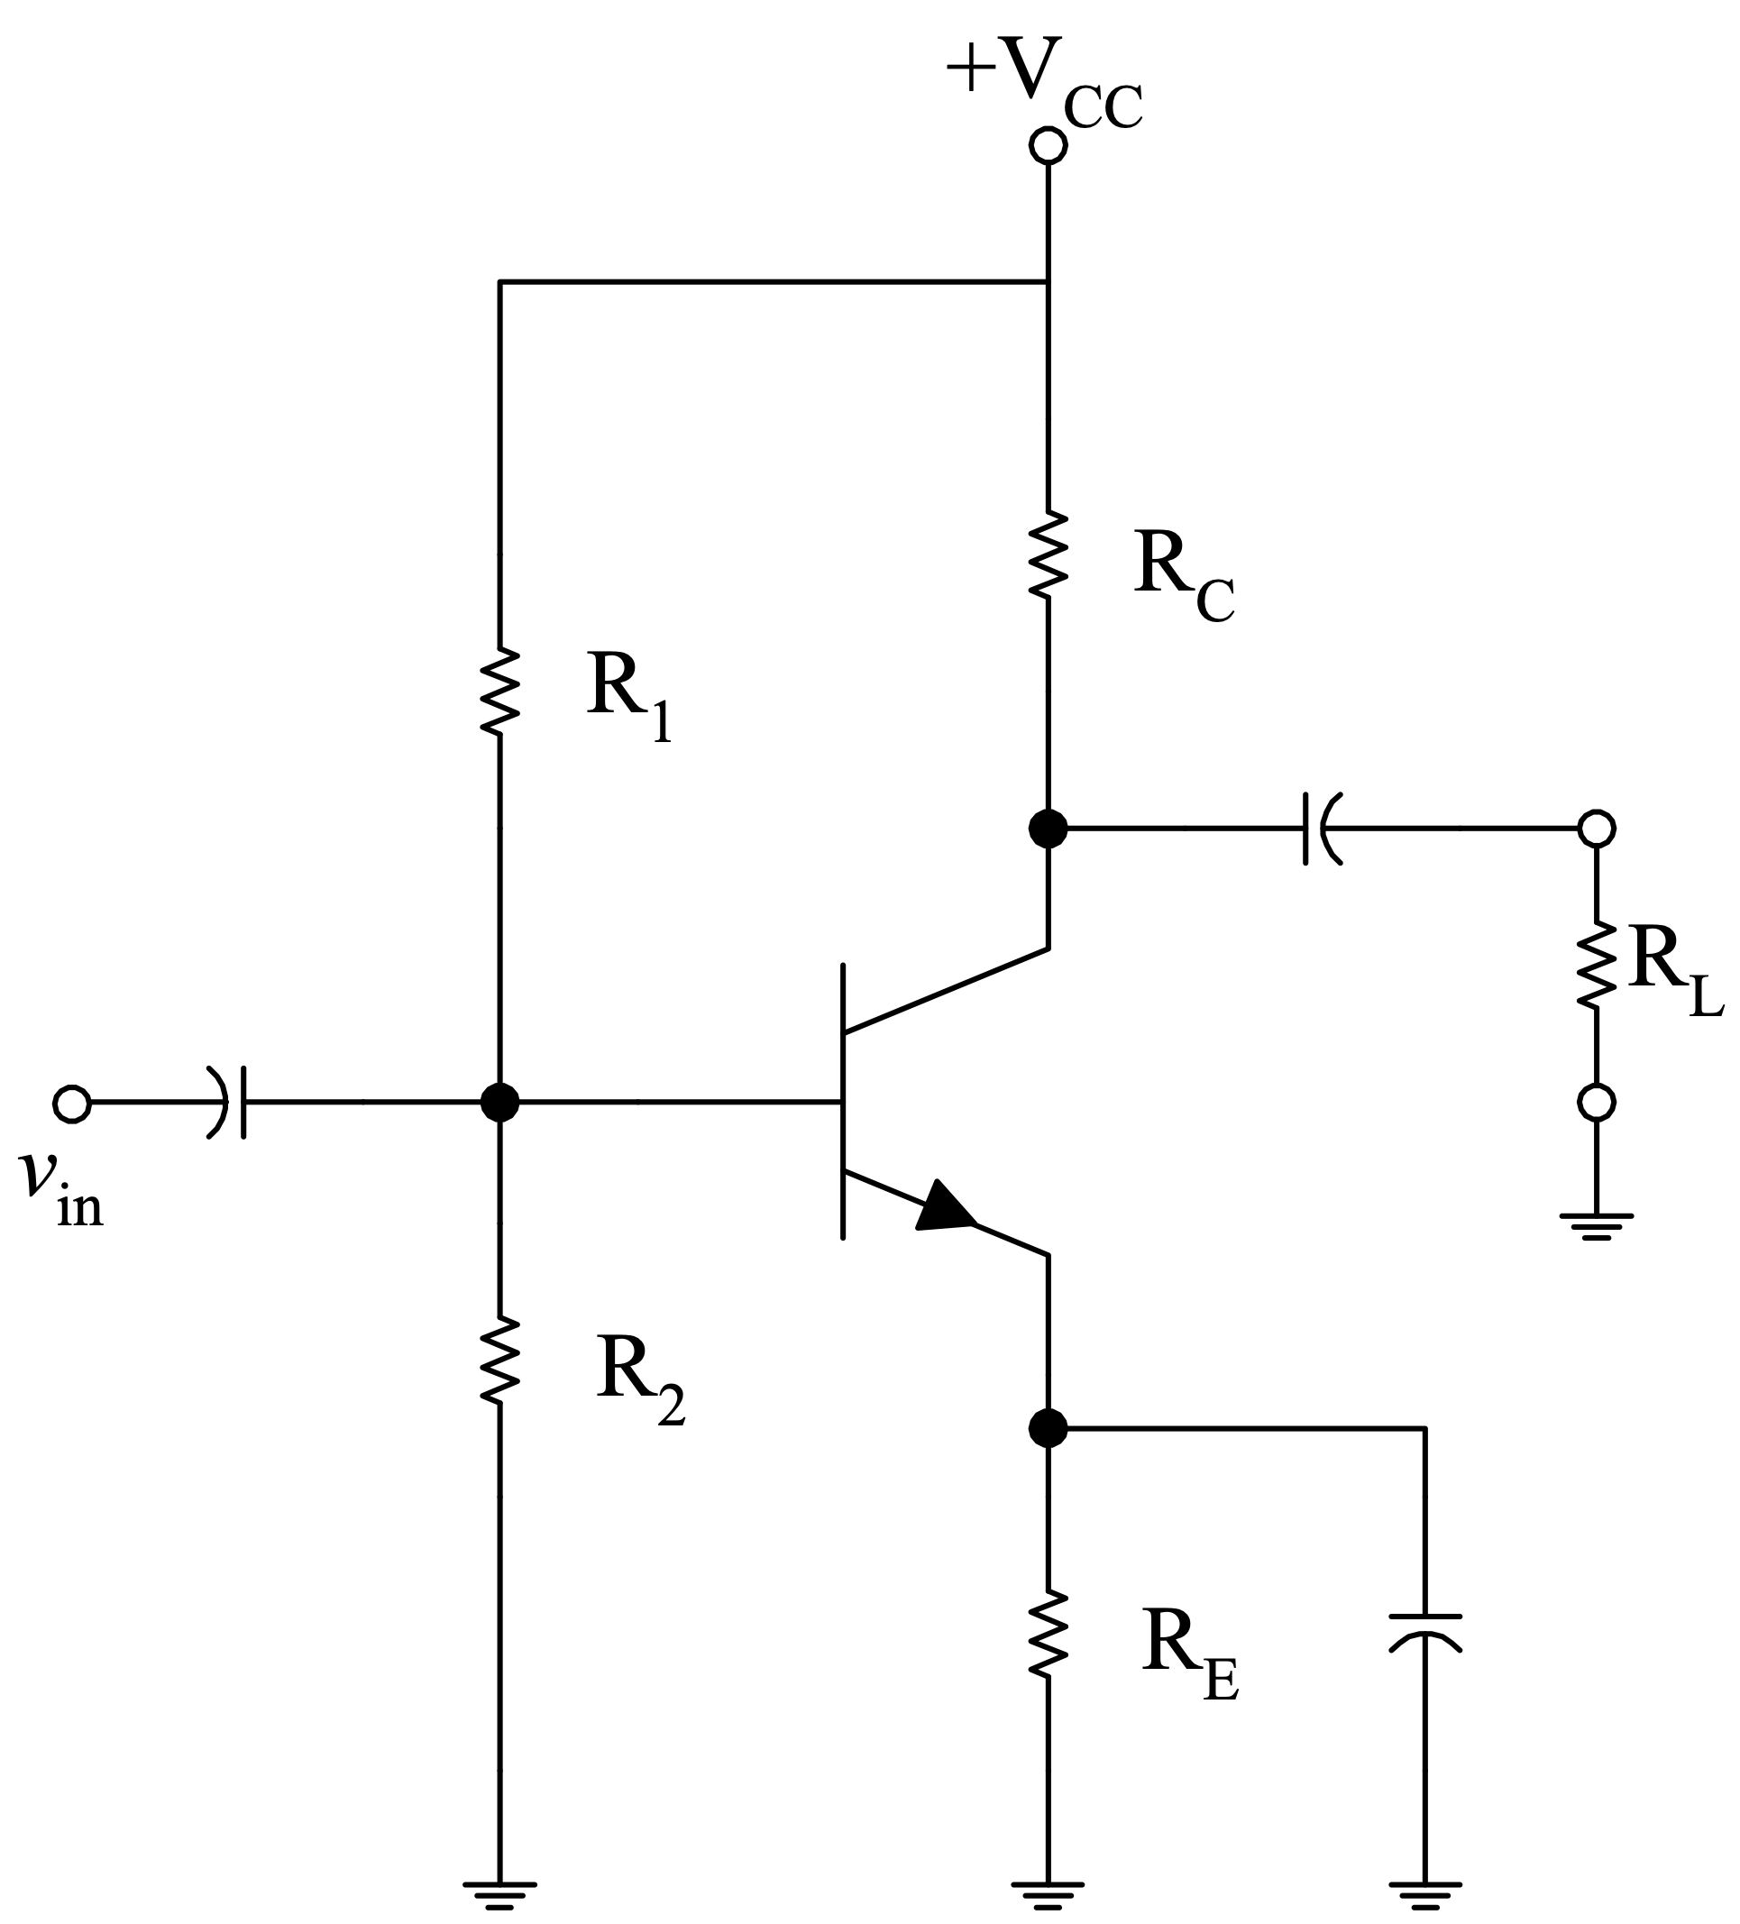
DC and AC load lines
R₁, R₂ ⇒ set the value of V_{B} , I_{B} at a given V_{CC}
R_{E} ⇒ stabilizes the Q point
R_{L} ⇒ Load
3/24/20
Notes:
We are now going to consider this common emitter amplifier to understand how to sketch the ac load line and what kind of information the ac load-line provides.

Slide 9
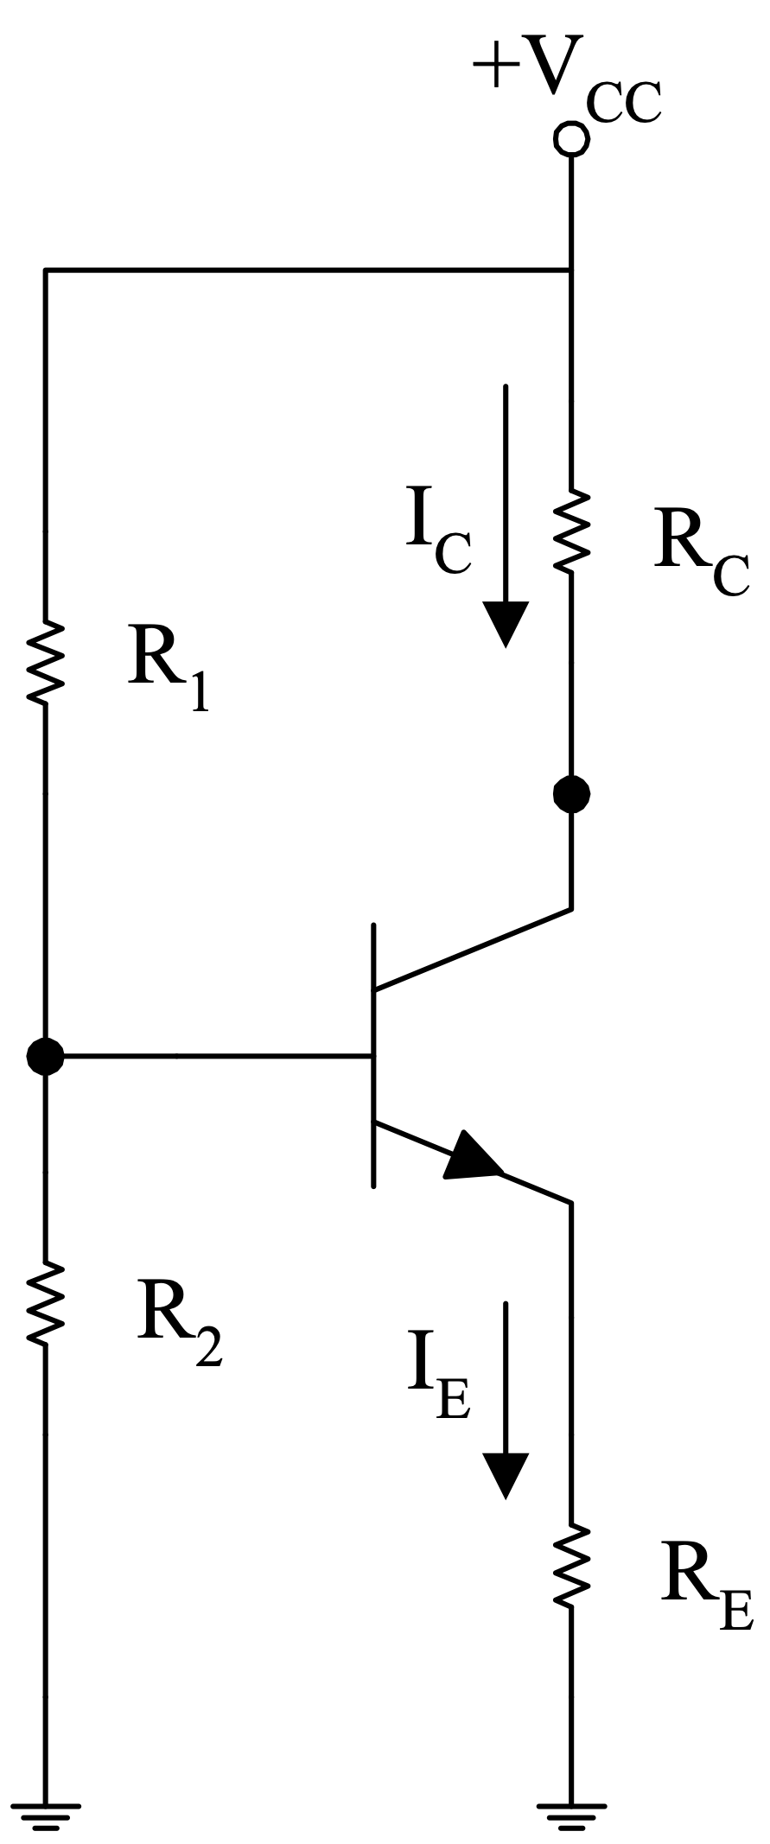
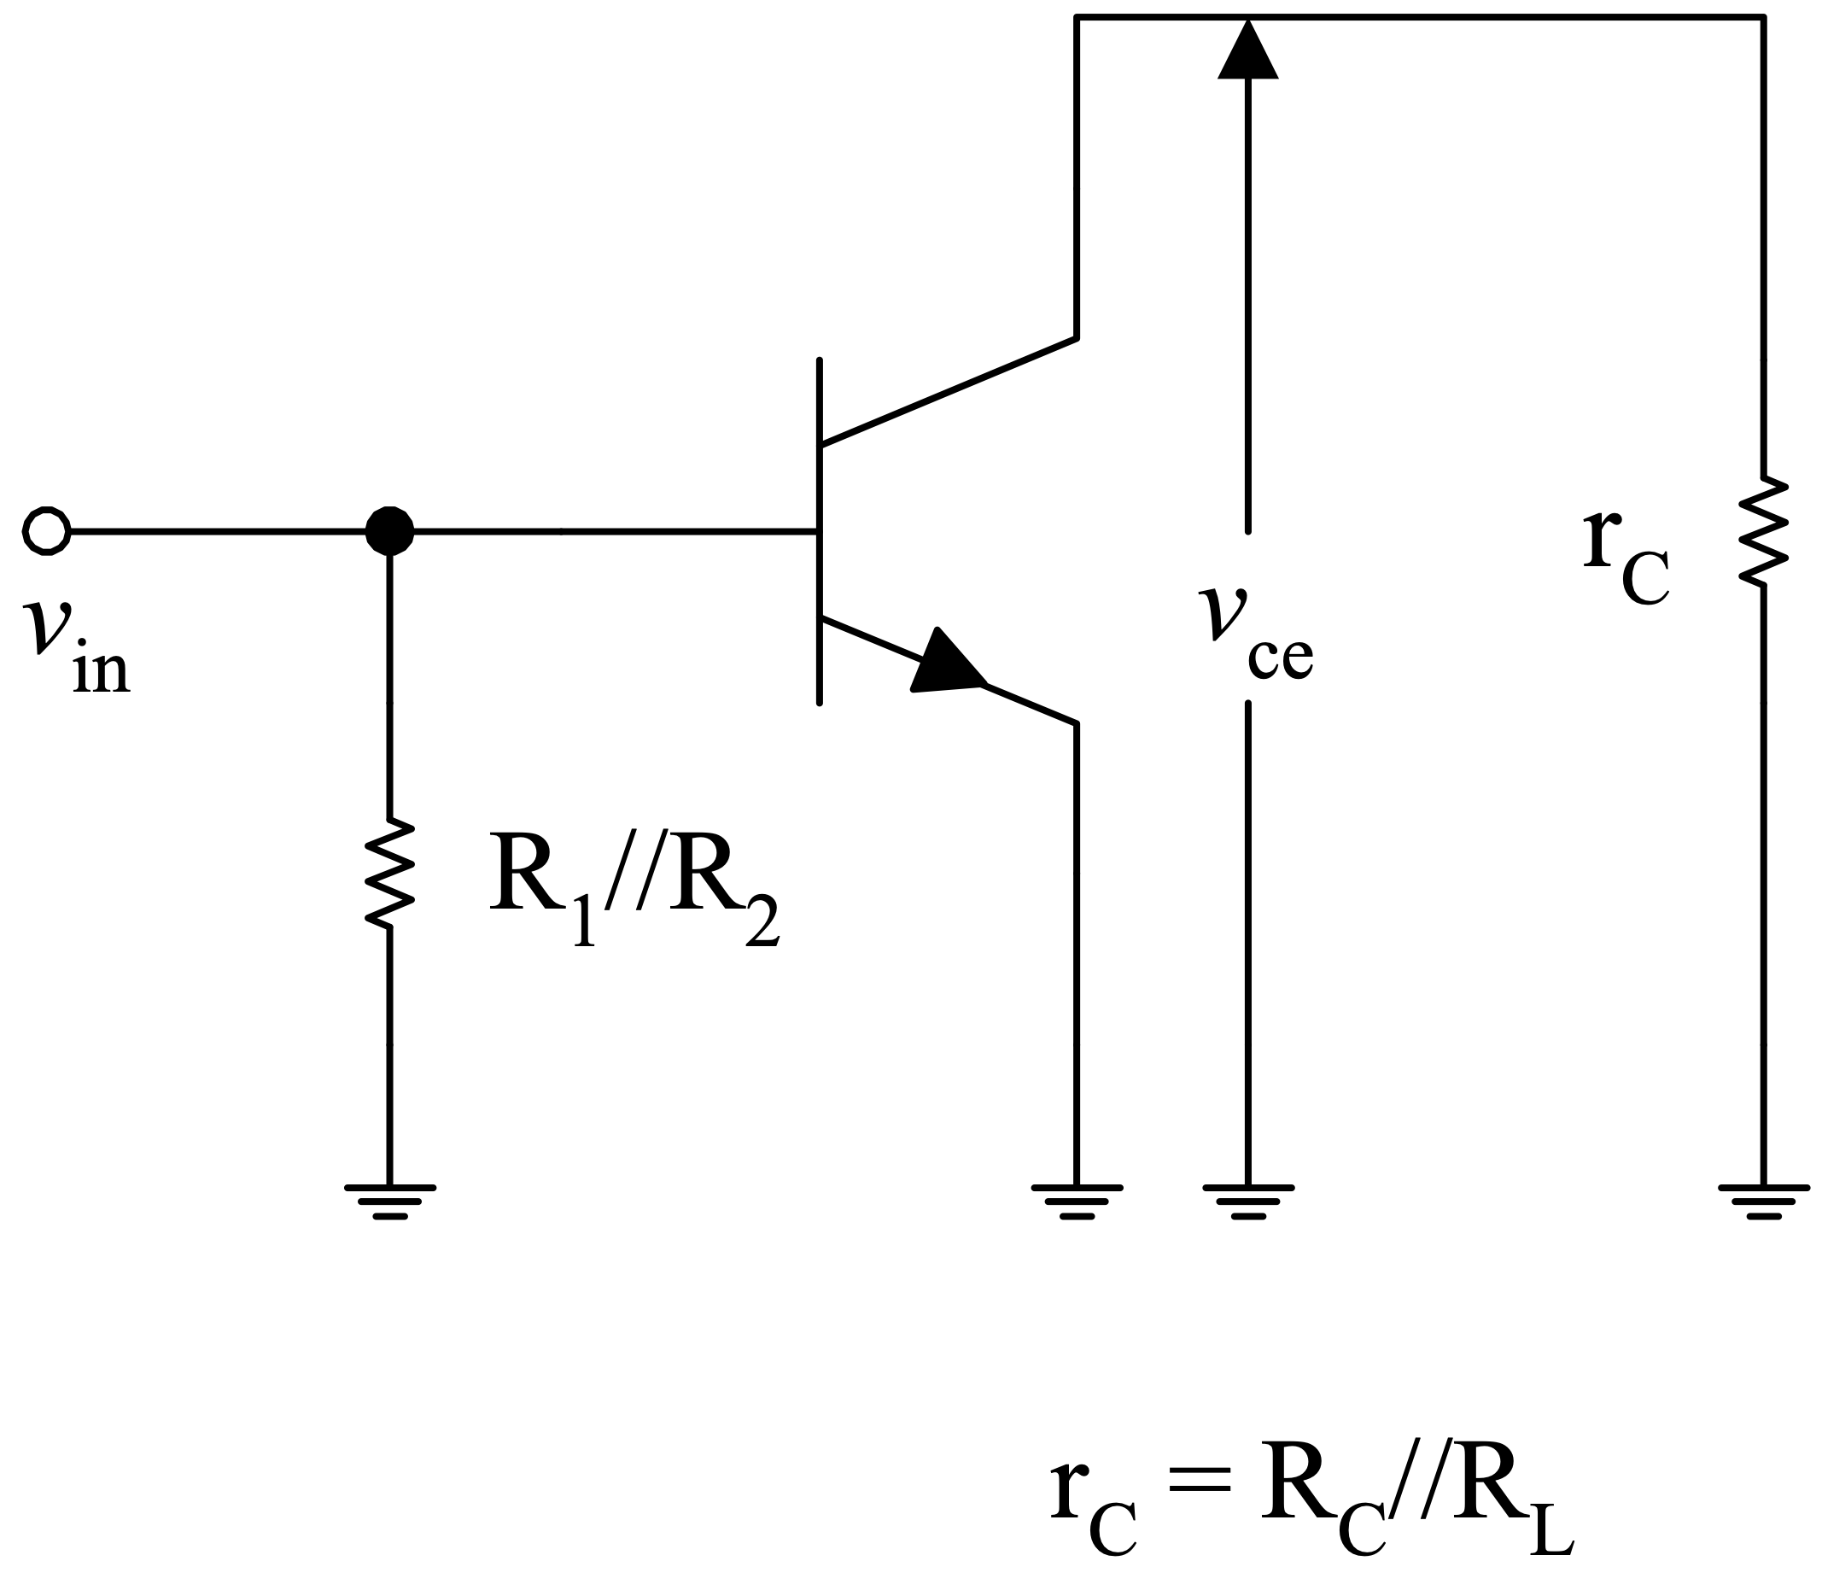
DC and AC circuits
Complete Circuit
DC circuit
AC circuit
3/24/20
Notes:
This slides shows the total circuit for the CE amplifier (left), the DC circuit (middle) and the AC circuit (right) in the midband.

Slide 10
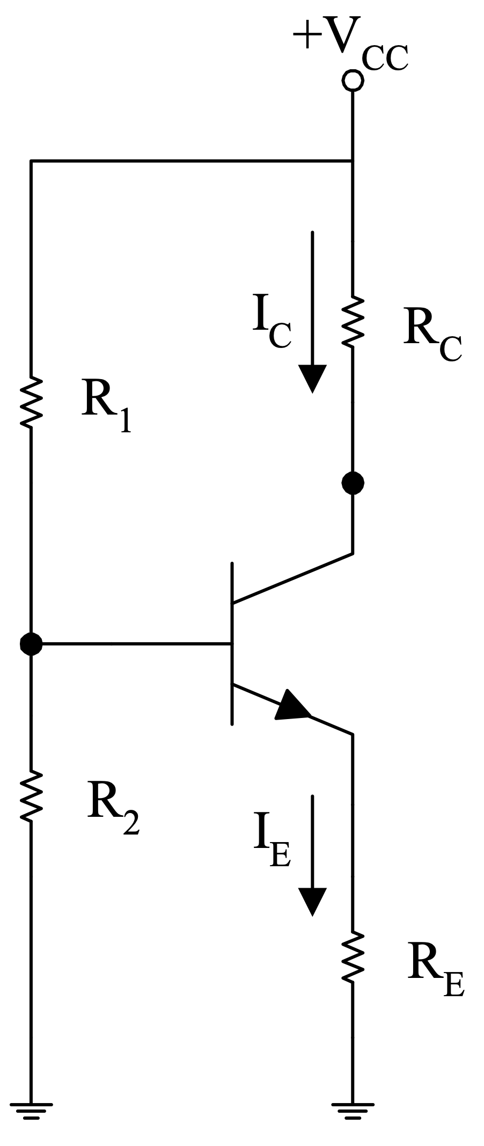
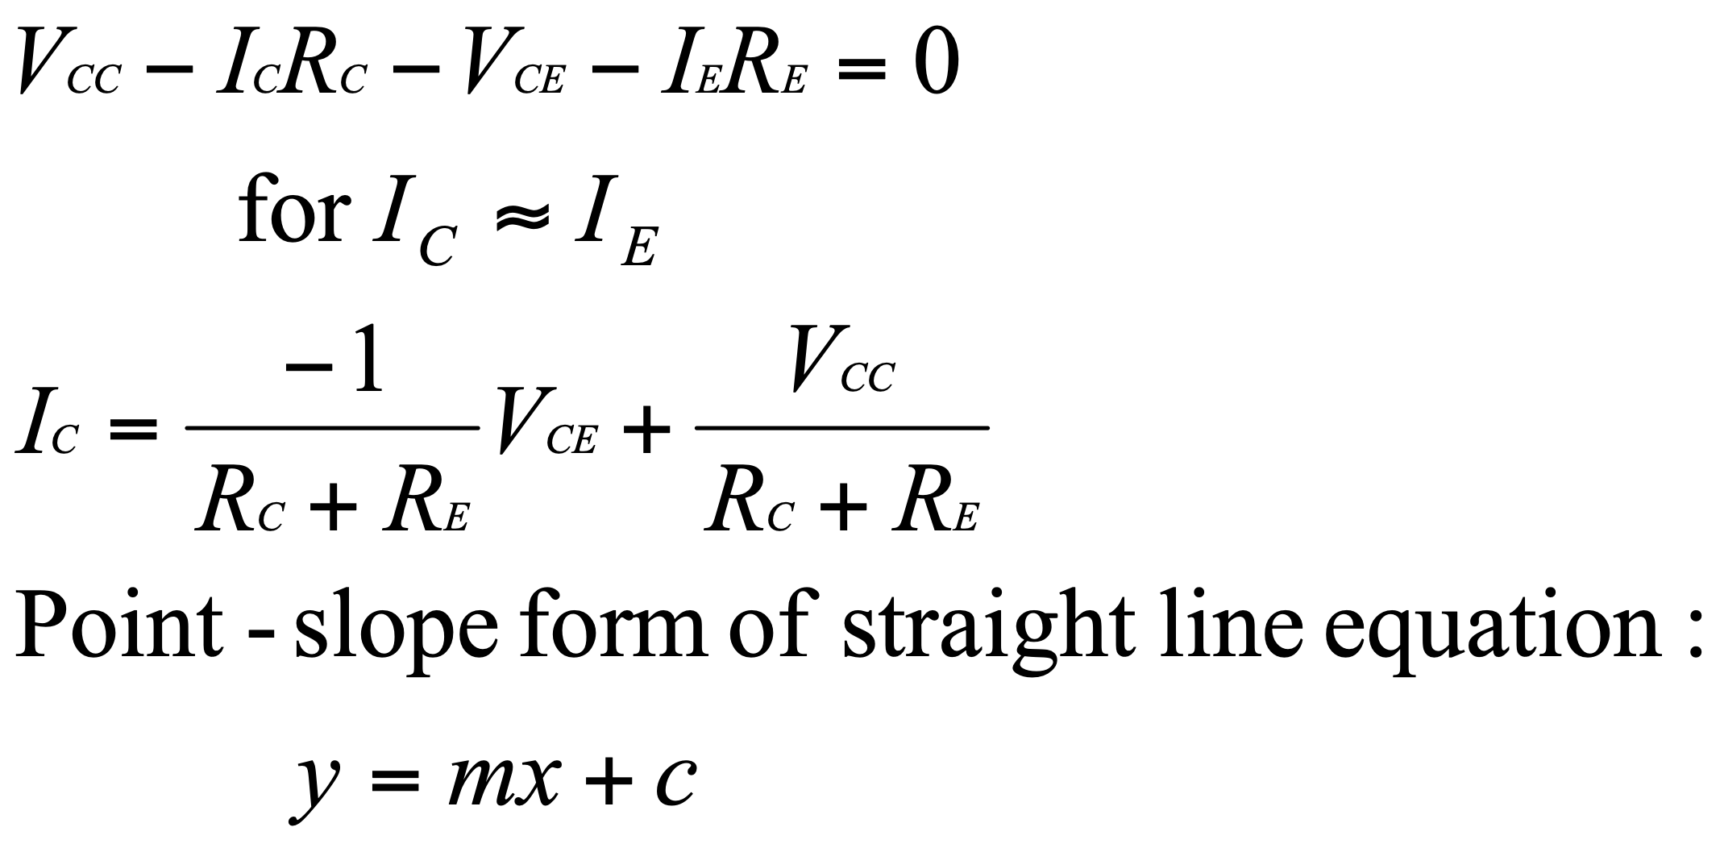
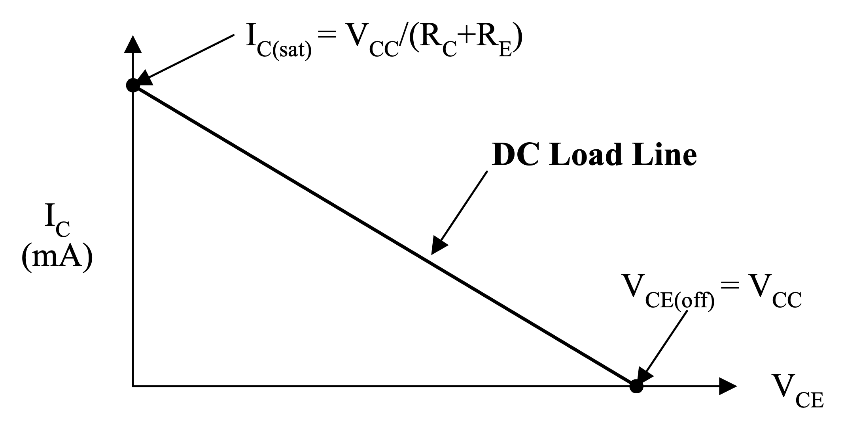
DC load line (Output)
We obtain the DC load line by writing a KVL on the C-E loop (output)
3/24/20
Notes:
This slides illustrates the process to obtain the equation of the DC load line and shows the DC load line.

Slide 11
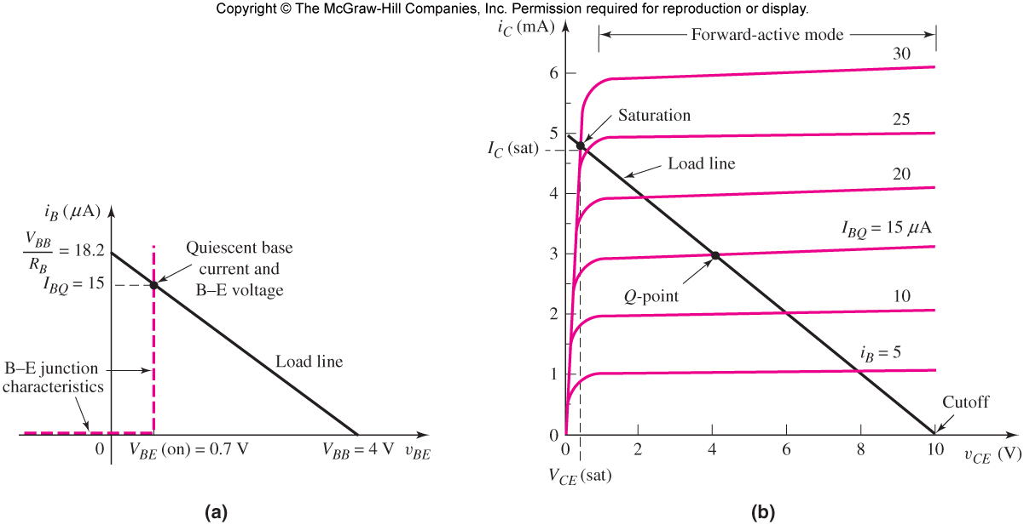
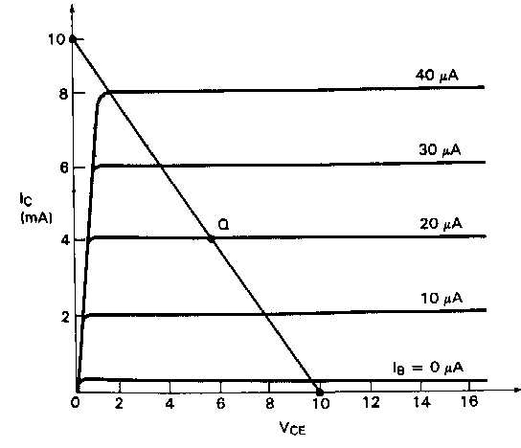
DC load line (Output)
The dc load line represents all the possible combinations of I_{C} and V_{CE} for a given amplifier
The DC load line is determined by the V_{CC}, R_{C} and R_{E}.
The collector current I_{C} and the collector-emitter voltage V_{CE} must lay on the DC load line.
The intersection of the transistor characteristics at the DC bias value of I_{BQ} with the DC load line determines the Q-point.
3/24/20
Notes:
This slides summarizes important facts about the DC load line

Slide 12
DC biasing and AC signal
The DC load line does not describe how the Q point changes in response to an applied ac input signal because dc and ac circuits have a different layouts, which yields different load lines.
Complete Circuit
DC circuit
AC circuit
3/24/20
Notes:
This slides explains why the DC load line doesn’t describe the variation of the Q point in response to an applied ac signal.

Slide 13
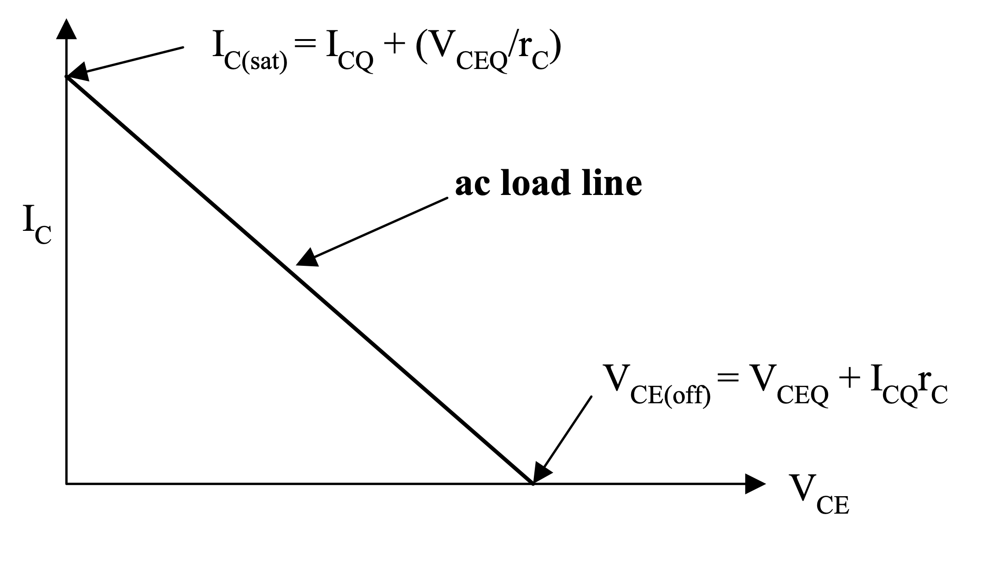

AC Load line
Equation of the ac load line
The AC load line can be sketched or plotted in the DC+AC plane just like the DC load line (see handout).
3/24/20
Notes:
This slides shows how to sketch the ac load line. The first step is to sketch the ac circuit. The second step is to write a KVL at the output loop. The KVL will yield the equation of the ac load line. Note that the ac load line will relate i_{c} (ac signal) to v_{ce} (ac signal). The third step is to determine the intercept of the ac load lines with the i_{C} and v_{CE} axis. The fourth step is to sketch the ac load line in the DC+AC space (i_{C}-v_{CE}). Please, see additional notes on this in lecture 16 folder.

Slide 14
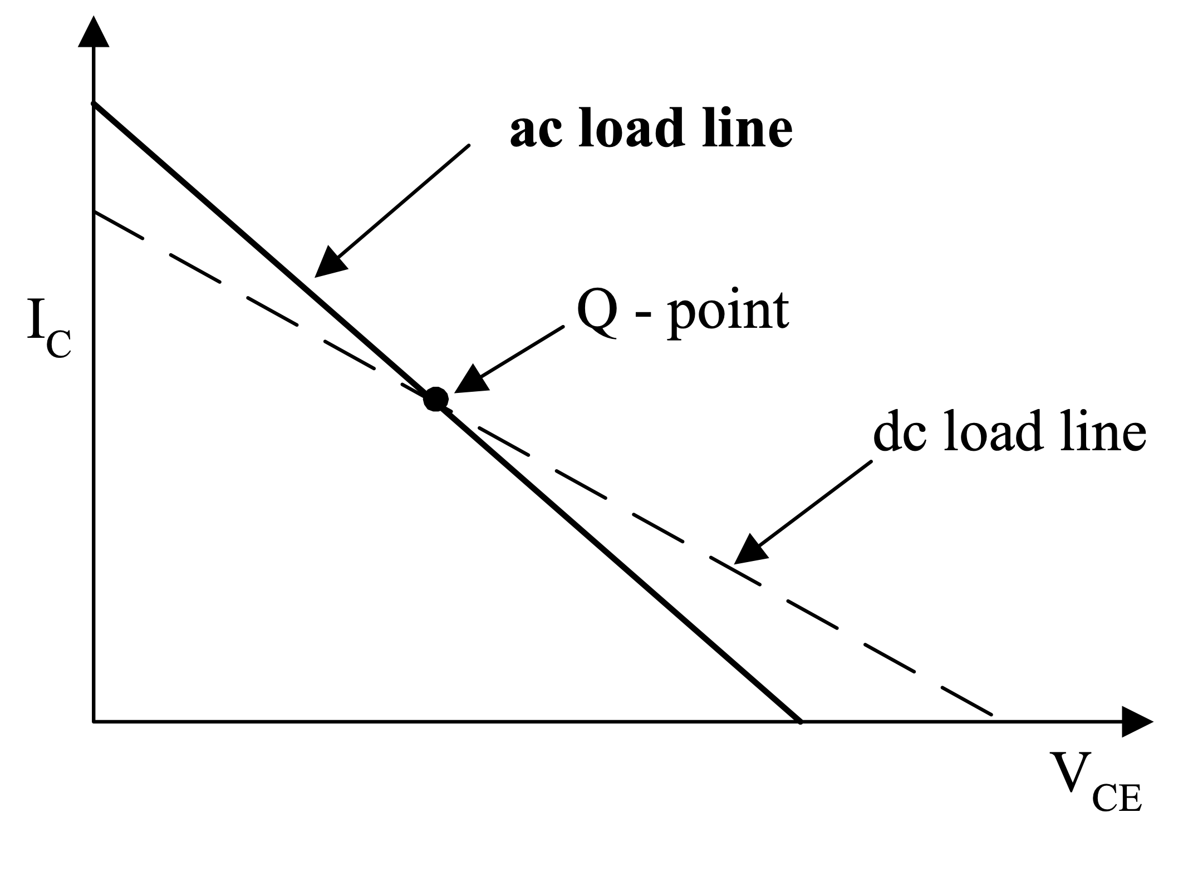
DC and AC Load Lines
The DC and the AC load lines
differ due to different layouts in DC and AC
3/24/20
Notes:
This slides compares the DC and AC load-lines. Typically the AC load line has higher slope than the DC load line as its slope is inversely proportional to the load resistance, which is small.

Slide 15
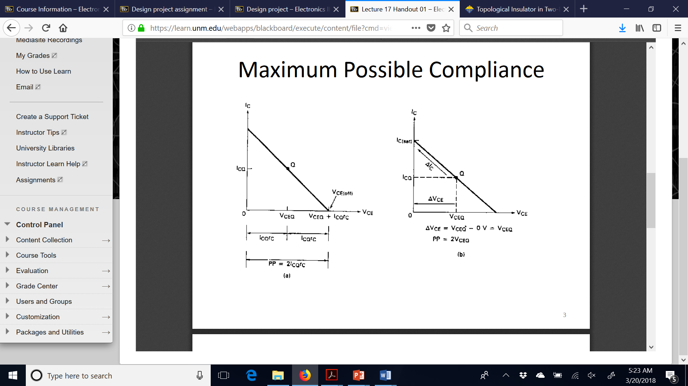
Compliance and AC load line
Compliance is determined by calculating the maximum range of output voltage (DC+AC) before the transistor enters cut-off and saturation.
The compliance of a voltage amplifier is determined using the concept of AC load line.
3/24/20
Notes:
The next few slides will show how to utilize the ac load line to calculate the compliance of the amplifier. As stated previously, the compliance is limited by the transistor entering saturation or cut-off. We will then determine some useful conditions for the transistor to enter saturation and cut-off based on the ac load line.

Slide 16
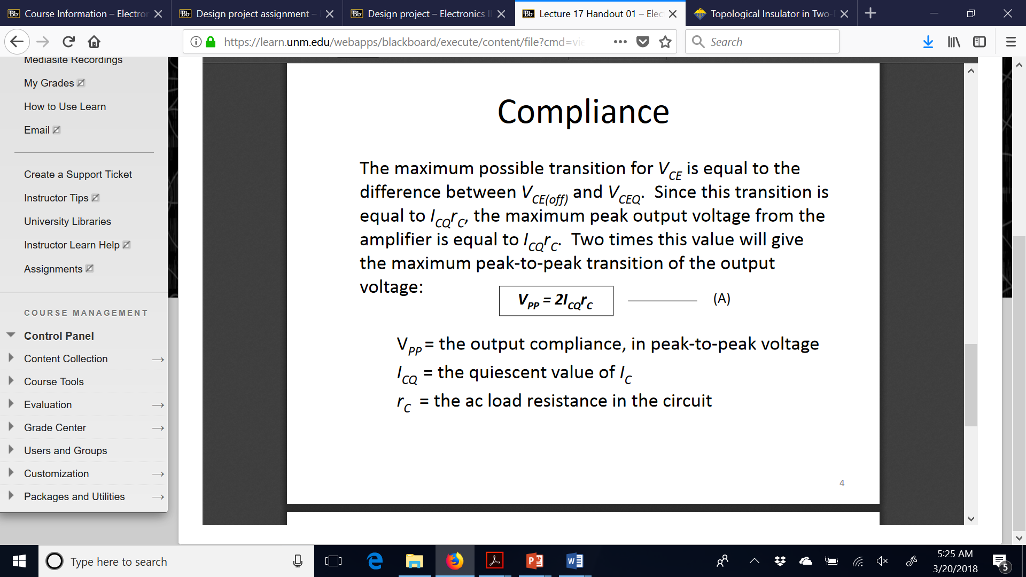
Cut-off limit
3/24/20
Notes:
This slides determines the limit posed on the v_{CE} by the BJT going into cut-off. The plot shows the ac load line in the i_{C}-v_{CE} space. Assume the transistor is biased at a certain V_{CEQ}. Now focus on the v_{CE} axis. The maximum possible change of the v_{CE} from the V_{CEQ} before the transistor goes in cut-off is I_{CQ}r_{c .} Twice this value will give the maximum peak to peak transition of the v_{CE.}

Slide 17
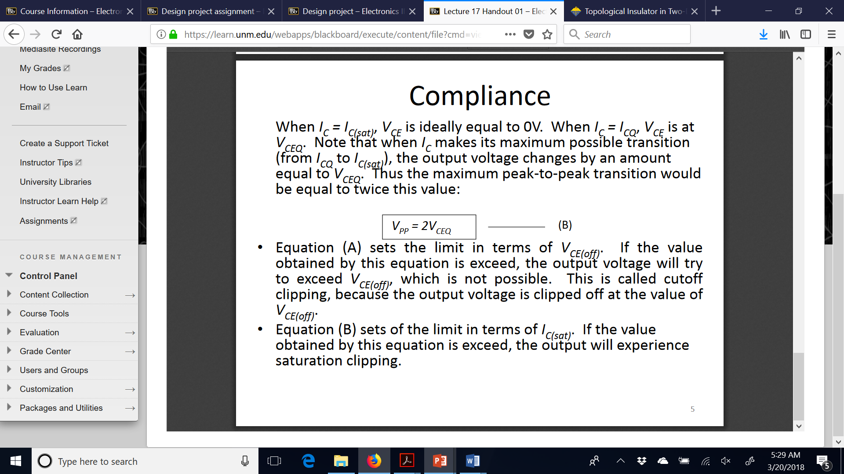
Saturation limit
3/24/20
Notes:
This slides determines the limit posed on the v_{CE} by the BJT going into saturation. The plot shows the ac load line in the i_{C}-v_{CE} space. Assume the transistor is biased at a certain V_{CEQ}. Now focus on the v_{CE} axis. The maximum possible change of the v_{CE} from the V_{CEQ} before the transistor goes in saturation is V_{CEQ .} Twice this value will give the maximum peak to peak transition of the v_{CE.}

Slide 18
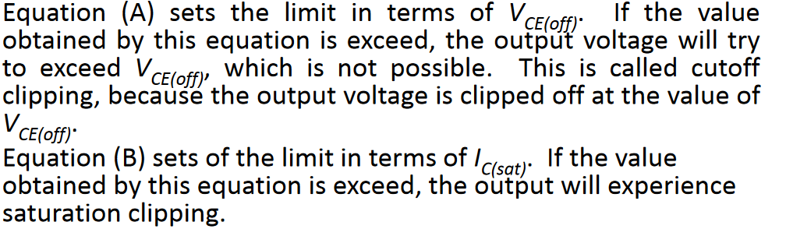
Compliance limits: summary
3/24/20
Notes:
Thelim peak-to-peak value of the output voltage is limited to the ranges A and B when the transistor enters cut-off or saturation, respectively.

Slide 19
Maximum symmetrical swing
Maximum peak-to-peak value of the output voltage which is symmetrical around the Q point.
Minimum between A and B
*Note that the absolute values of I_{CQ} and V_{CEQ} should be used to calculate compliance and maximum symmetrical swing.
3/24/20
Notes:
In order to determine the maximum symmetrical swing of the output voltage one will have to determine the peak-to-peak limits imposed by to the voltage values by the transistor going in cut-off or saturation (Conditions A and B). This will require to determine the Q point and the slope of the ac load line. Then you will have to take the minimum value between the peak-to-peak voltages that you calculated using conditions A and B. Selecting the minimum value between the two will ensure that the swing is not only maximum but also symmetrical.

Slide 20
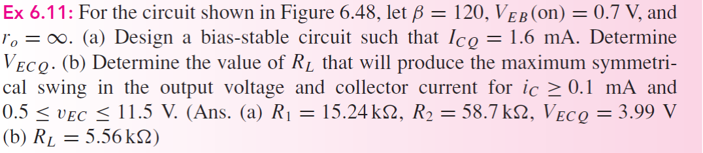
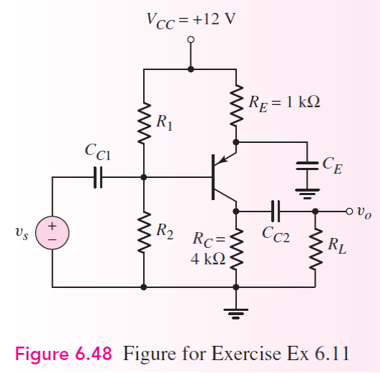
Lecture 16, In class problem
Design a bias stable circuit such that the collector current is 1.6 mA.
Determine the maximum symmetrical swing for a load of 8 Ω and for a load of 5kΩ
*See solution in the handout within lecture 16 folder.
3/24/20

Slide 21
Lecture 16, Take home problem
Note: Part a is the same as the in class problem.
3/24/20

Slide 22
Overview of lecture 17
Amplifier gain vs frequency (Neamen 7.1)
Low-frequency response of an amplifier (Neamen 7.3)
Please, review the handout about simple transfer functions and Bode plots (Neamen 7.2) before Lecture 17
3/24/20

